Slide 1
Caches: part 2
Alexandr Misevich
2 December 2019

Slide 2
Agenda, part 2
Memory Wall
Spatial and temporal locality
Hardware implementations
Performance metrics
Software optimizations
Hardware optimizations
Prefetching
Replacement
Write handling
Multi-level cache organization
Modeling in simulator

Slide 3
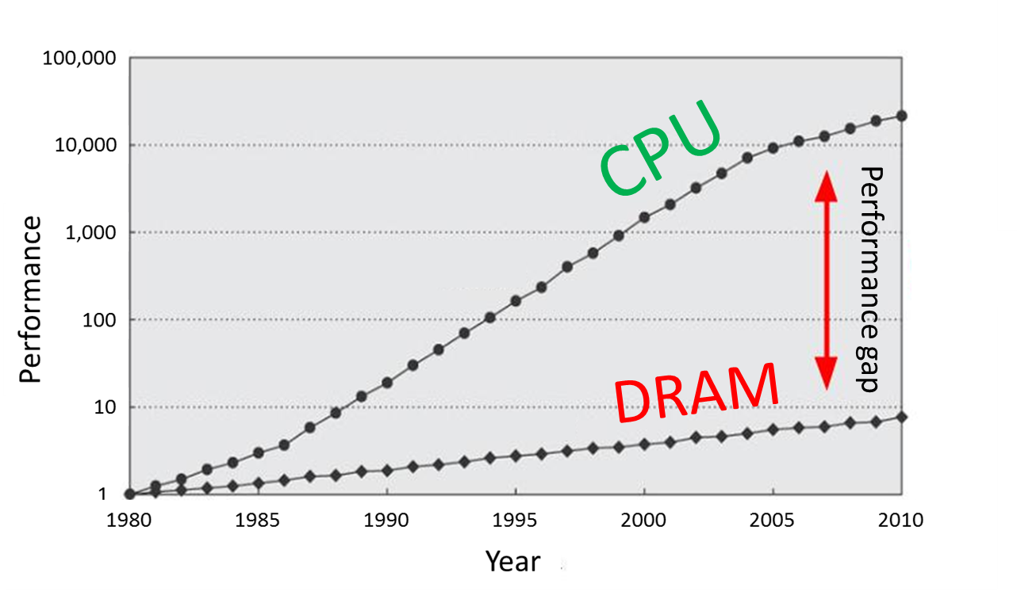
Refresher
Main memory is large, but slow
Solution: memory hierarchy with caches
utilizes temporal and spatial locality of workloads
provides visibility that memory is usually fast
Bad scenario: cache misses
Compulsory
Capacity
Conflict
L3
Cache
Main Memory
L1
L2
CPU
smallest, but fastest
slowest, but largest

Slide 4
Prefetching

Slide 5
Prefetching: main idea
Prefetching – predict future memory accesses
A useful prefetch eliminates a potential cache miss
2 types of prefetching:
Software Prefetching: special prefetching instructions
Hardware Prefetching
Code prefetching is performed by a branch predictor
Prefetch Limitations
Prefetching relies on extra memory bandwidth
Too aggressive/inaccurate prefetching slows down demand fetches

Slide 6
Quality metrics
Accuracy
Portion of prefetched lines which eventually become demand-hits
Coverage
Portion of cache misses removed by prefetching
Timeliness
Reduction of cache miss time
For L1 cache prefetch schemes with high accuracy are used
Bigger caches usually leverage schemes with higher coverage

Slide 7
Next sequential
On a cache miss, prefetch sequential cache line (± 64 bytes)
Prefetch metrics:
Moderate accuracy
Low coverage
Lack of timeliness (prefetch performed too late)
Simple HW
Works well for instructions prefetch
“Fallback" if more complex methods not available
lw $t0, 0x0($t1)
prefetch 0x40($t1)

Slide 8
Stride detection
HW detects the repetitive step of a load and prefetch data in advance
Prefetch metrics:
High accuracy (for long loops)
Low coverage
Highly timeliness
Issues with unrolled loops
Initially single load operation occupies multiple entries in detector
Detector
0x00402f0: lw $t0, 0x20($t1)
0x00402f4: add $t2, $t2, $t0
0x00402f8: addi $t1, $t1, 0x100
0x00402fc: beq $t1, $t3, -4
IP | Stride | Last address
0x00402f0 | 0x100 | 0x00f4180
prefetch 0x00f4280
prefetch 0x00f4380
...

Slide 9
Stream detection (1)
HW detects stream with the repetitive step
Similar to the previous technique, but without reference to IP
Example:
0xba20200
0x3cf1140 0xba203с0
0x3cf1100
0x3cf10c0
0x3cf1080
0xba20740
0xba20900
...
0xba20200
0x3cf1140 0xba203с0
0x3cf1100
0x3cf10c0
0x3cf1080
0xba20740
0xba20900
...
Base address | Stride | Last address
0xba20200 | +0x1c0 | 0xba20900
0x3cf1140 | −0x40 | 0x3cf1080
prefetch 0xba20ac0
prefetch 0x3cf1040
...

Slide 10
Stream detection (2)
Stream detection without repetitive step
load pattern not found, only direction – load everything following this direction
Prefetch metrics:
Low accuracy
High coverage
Highly timeliness
0xba20200 0xba20340
0xba203a0
0xba204с0
0xba20520
...
Base address | Stride | Last address
0xba20200 | +????
prefetch 0xba20560
prefetch 0xba205a0
...

Slide 11
Replacement

Slide 12
Cache Line Replacement
When miss occurs need to free space in a cache for a new line
Direct mapped cache
A new line is mapped to a single entry → evict old line from the entry
N-way set associative cache
Choose a victim from all ways in the appropriate set, but how?
FIFO (First In First Out) replacement
Easy to implement in HW, but can violate temporal locality
LRU (Least Recently Used) replacement
Evict the most unused line (was not accessed longer than other)
Good temporal locality, but complex HW → use simplified pseudo-LRU

Slide 13
Pseudo-LRU
Pseudo-LRU is a good approximation of LRU with a binary tree
Each node stores information about which of the descendants was recently used
Request «B»
Request «A»
Request «E»
L
R
R
L
R
L
L
L
R
L
R
R
A
B
C
D
A
B
C
D
A
B
C
D
A
B
E
D

Slide 14
Counterexample
Sometimes there is no temporal locality
Example: read of large data array (data size >> cache size)
In case of LRU the second loop will always ‘miss’
If data eviction follows MRU policy (most-recently used) the second loop will start with ‘hit’
for (size_t i = 0; i < N; ++i)
sum += a[i];
double average = sum / N; for (size_t i = 0; i < N; ++i)
a[i] -= average;

Slide 15
Write handling

Slide 16
Cache write policies
Memory writes (store instructions) also need to update a cache
WriteThrough: always update both memory and cache
+ Coherence: cache and memory are always in the same state
- Higher utilization of memory bandwidth
WriteBack: update only cache, update memory at line eviction
+ Low store latency and memory bandwidth
- Risk of data loss, requires snoops – coherency checks

Slide 17
Multi-level cache organization

Slide 18
Motivation for multi-level caches
Only L1 cache: a large miss penalty due to memory access
With L2 cache: L1 miss penalty is reduced
Now, on L1 miss we access L2, not memory
L2 Cache is larger (lower MissRate), but has higher latency
Example:
L2
Main Memory
CPU
L1
<T> ≈ T_L1hit + MissRateL1 * T_mem
<T> ≈ T_L1hit + MissRateL1 * (T_L2hit + MissRateL2 * T_mem)
<T> ≈ 3 + 0.08 * 200 = 19 clk
x5 !
<T> ≈ 3 + 0.08 * (6 + 0.03 * 200) = 3.96 clk

Slide 19
Multi-level inclusion policies
1. Inclusive
2. Exclusive
3. Non-Inclusive/Non-Exclusive (NINE)
M/NM
L1
modified only
M/NM
L1
L1
modified only
L2
L2
L2
modified only
modified only
+ low bandwidth
- lines duplications
+ effective cache usage
- higher bandwidth
combination of 2 policies

